Slide 1
Task Management System
Java Mini Project

Slide 2
Table of Content
Introduction
Project Team
Project Overview
Project Features
Add Task Feature
Task Status Feature
View Tasks List Feature
Future Improvements
Conclusion
References
Thank you

Slide 3

Project team
Our project team consisted of three individuals.
The member are
22DCE068 - Harsh Patel
22DCE069 - Hemax Patel
22DCE070 - Het Patel
Each member brought a unique perspective and expertise to the table, which allowed us to collaborate effectively and develop a successful task management system.

Slide 4

Project Overview
Our task management system project is designed to help individuals manage their tasks more effectively.
The purpose of the project is to provide an intuitive and user-friendly system that allows users to create, assign, and track tasks from start to finish.
The system comes equipped with a range of features that make task management a breeze.

Slide 5

Project Features
The task management system project includes several key features that make it a powerful tool for organizing and managing tasks.
The features are:
Add task feature.
Task’s status.
View tasks list.

Slide 6
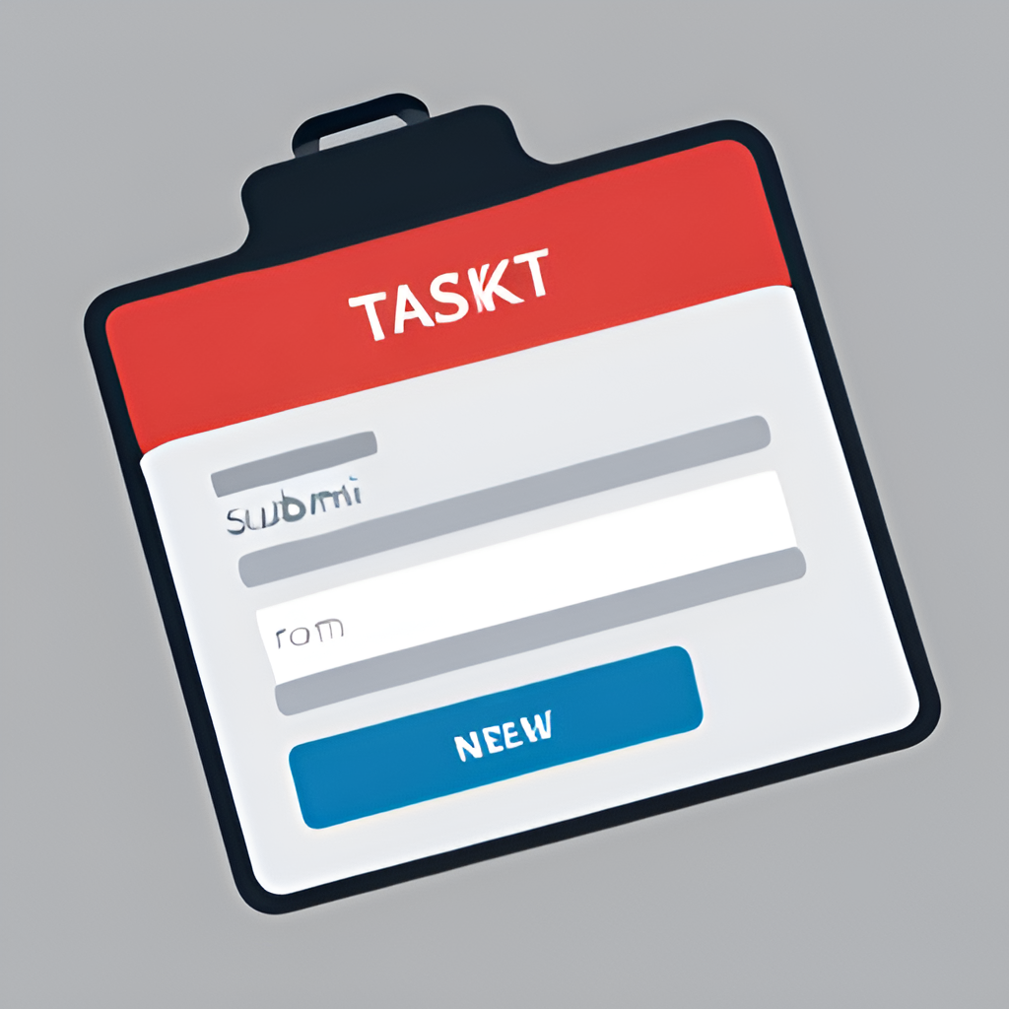
Add task feature
It allows users to easily create new tasks and add them to the system.
This includes the task name, description and due date.
Once you have filled in all the necessary information, simply click enter and the task will be added to the system.

Slide 7
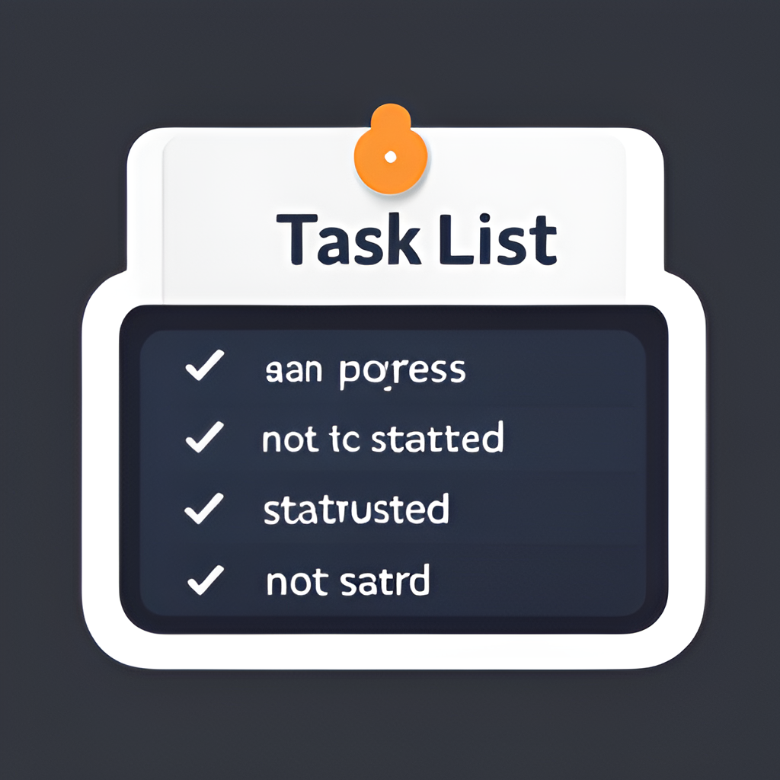
Task’s status feature
When a user creates a new task, after that they can assign it a status of completed or not.
This status is displayed alongside the task name in the task list, making it easy for users to see which tasks are still outstanding and which ones have been completed.

Slide 8
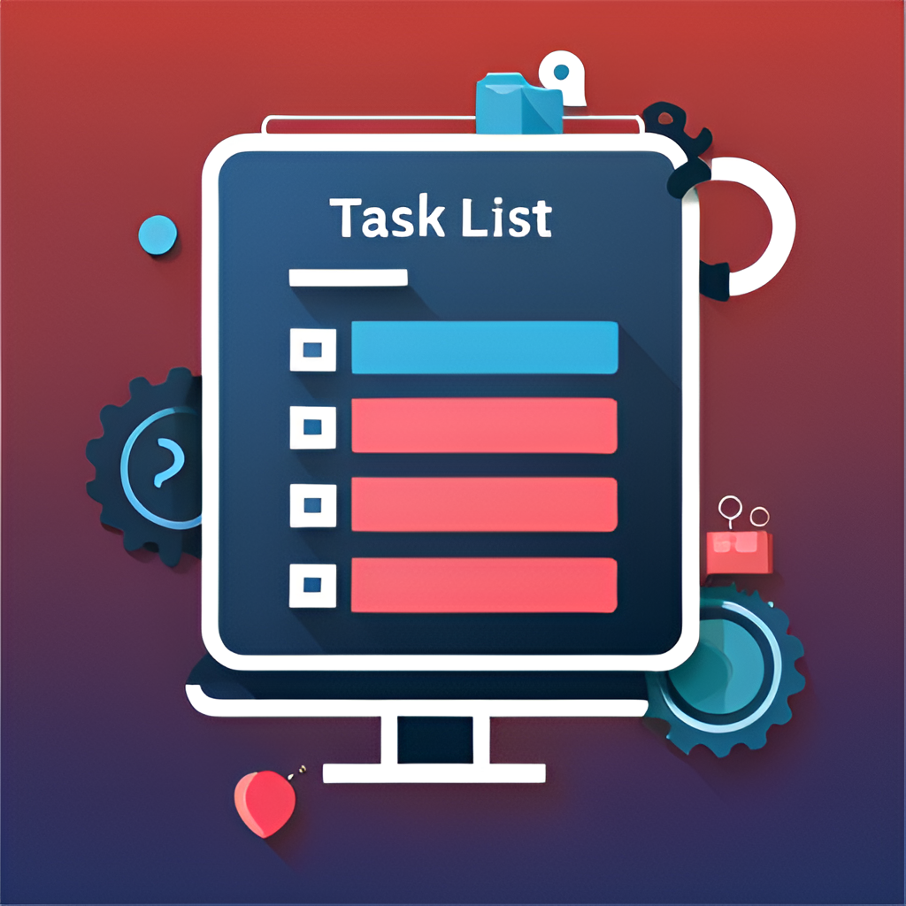
View task list feature
It allows users to see a comprehensive list of all the tasks in the system, including their status.
This feature provides a quick and easy way to get an overview of all the tasks in the system and helps users stay organized and on top of their work.

Slide 9

Future Improvement
One potential future improvement for our task management system is to try to add some more tools/features.
Another area for improvement is the user interface design. We could explore more modern and intuitive designs, such as using a card-based layout or implementing a dark mode option.

Slide 10

Conclusion
In conclusion, we have presented a task management system project that aims to simplify and streamline the task management process for individuals and teams.
The project features three key functionalities: add task, task status, and view tasks list.
Through our presentation, we have demonstrated how each of these features works .

Slide 11

Reference
The task management system project utilized a variety of references in its development, including programming guides, tutorials, and online resources.
These references were carefully chosen to ensure the project was built using best practices and up-to-date techniques.

Slide 12

Thank you

